Slide 1
OGC API for Processes
OGC API Hackathon 2019
London, United Kingdom
20 June 2019

Slide 2
OGC API for Processes
Initially REST/JSON Binding Extension for WPS 2.0
Developed in OGC Testbed 12
Evolved over the last 2 years
Alignment with WFS 3.0 (API for Features)
OpenAPI specification
Overall document structure
Moves towards a standalone OGC API for Processes
Probably no 1:1 matching with WPS 2.0 functionality
For example a list of Jobs is not specified in WPS 2.0
However, still almost completely based on WPS concepts

Slide 3
OGC API for Processes
Defines (core) Resources and Operations, Abstract Test Suite
https://github.com/opengeospatial/wps-rest-binding
OpenAPI specification
https://app.swaggerhub.com/apis/geoprocessing/WPS/1.0-draft
Possible extensions
Transactional extension
Job monitoring (pause/delete job)

Slide 4
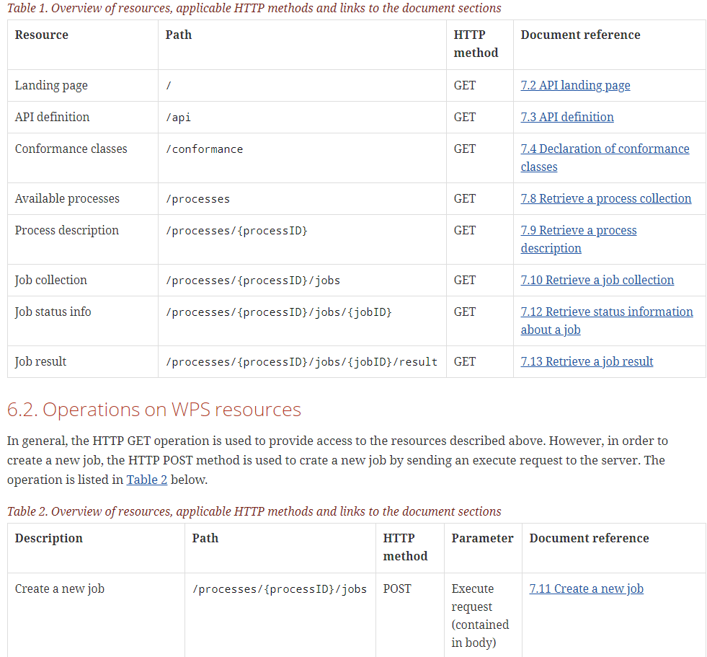
Resources of the API

Slide 5
Hackathon Goals
Validate concepts
Discuss possible issues
Discuss extensions/profiles (e.g. Transactional, Routing API)
Show evidence of implementation
Finalize Tests
Implement Executable Test Suite

